Slide 1

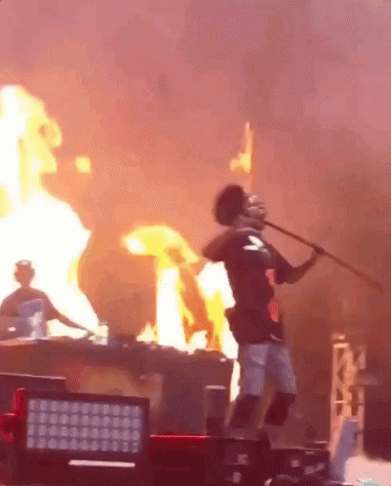
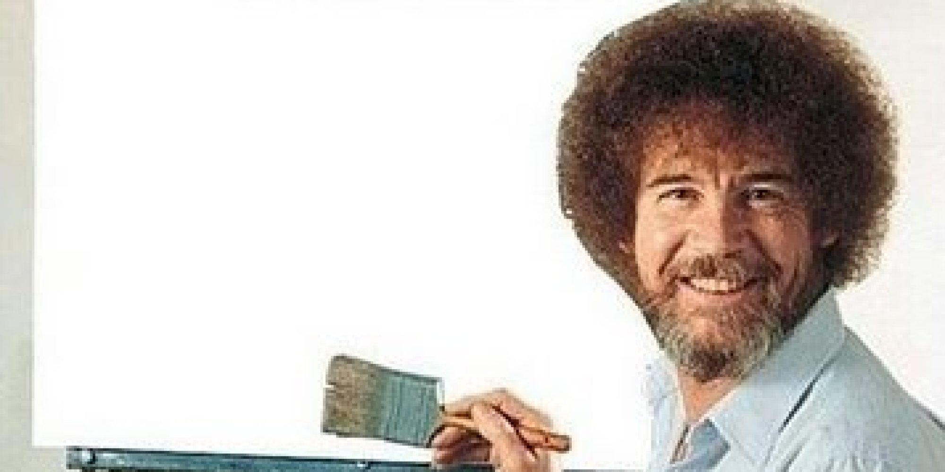
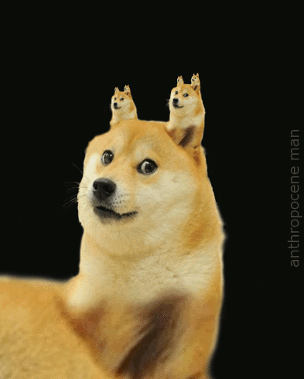



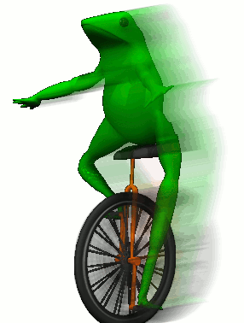


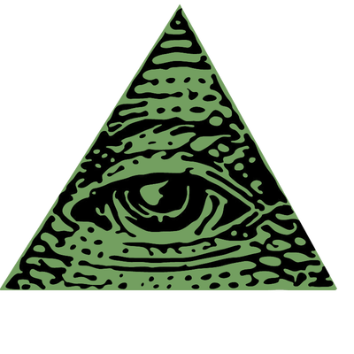


BASH is really cool
BASH
Seizing The Memes Of Production
Notes:
Speaker order:
Intro: Terry
1st iteration: James
2nd: Terry
3rd: James
4th: Terry
5th: James

Slide 2
BASH
Unix Shell & Command Language
Bourne Again Shell
Written by Brian Fox in 1989 to replace the Bourne Shell
https://www.gnu.org/software/bash/
Notes:
Speaker order:
Intro: Terry
1st iteration: James
2nd: Terry
3rd: James
4th: Terry
5th: James

Slide 3
Meme Generator Script
Stripped-down version of this script we found
Original author: Navan Chauhan (github.com/navanchauhan)
Generates memes using memegen.link/
Source code: git.redbrick.dcu.ie/tbolt/bash-talk-2018

Slide 4
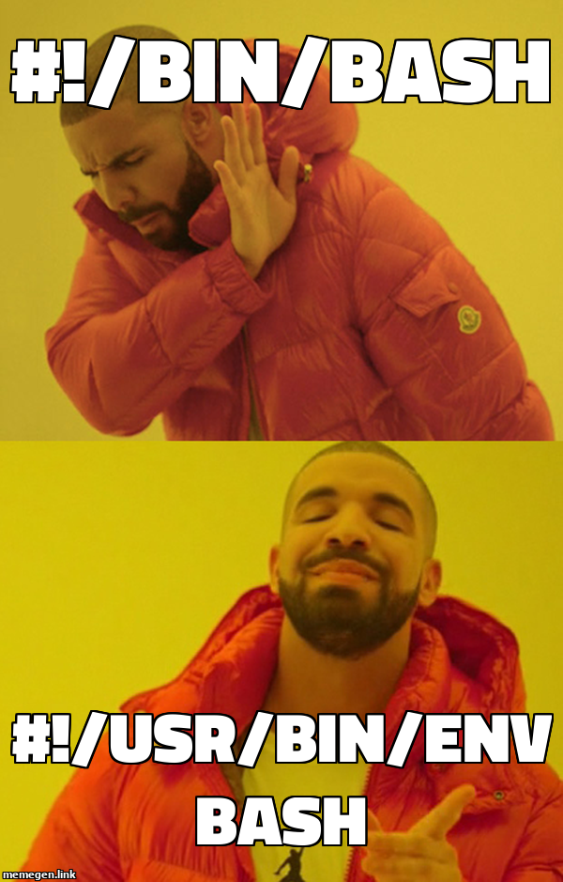

Slide 5
Some notes
In some cases, particularly on DCU machines, the .jpg extension doesn’t work. Swap for .png in this case.
If at first your script doesn’t work, don’t be disheartened, one of us will help you out!

Slide 6
First iteration
Prompt user for meme information
Variables
Fetch meme using curl
File redirection

Slide 7
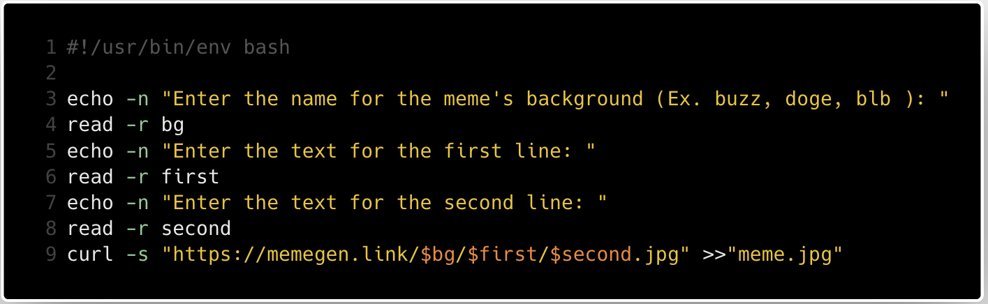

Slide 8
How to run your script
Save your script as meme.sh
On the command line run chmod +x meme.sh
Run ./meme.sh on the command line.

Slide 9
Second iteration
Let the user change the file name
Give a default file name if they don't provide one
Conditionals

Slide 10
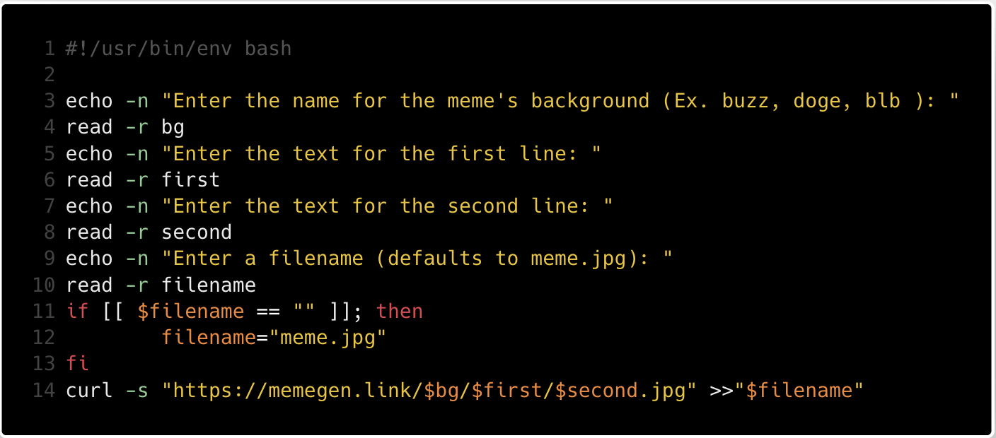

Slide 11
Third iteration
Make the program "scriptable"
But first we need a main function

Slide 12
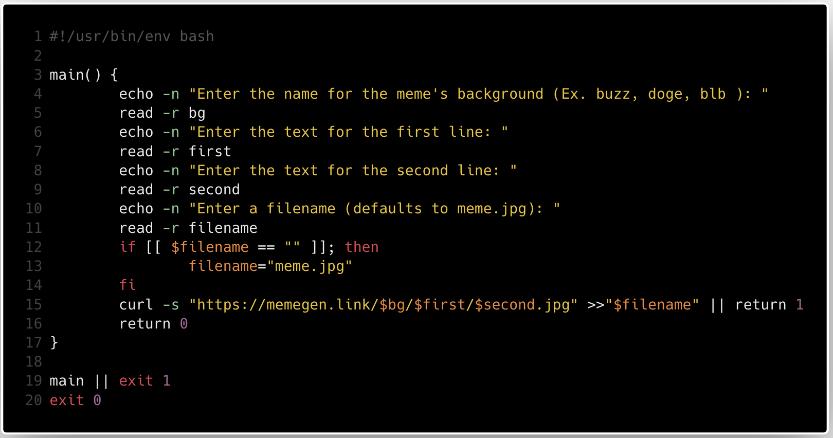

Slide 13
Fourth iteration
Make it only prompt the user if it has to
Add arguments using getopts

Slide 14
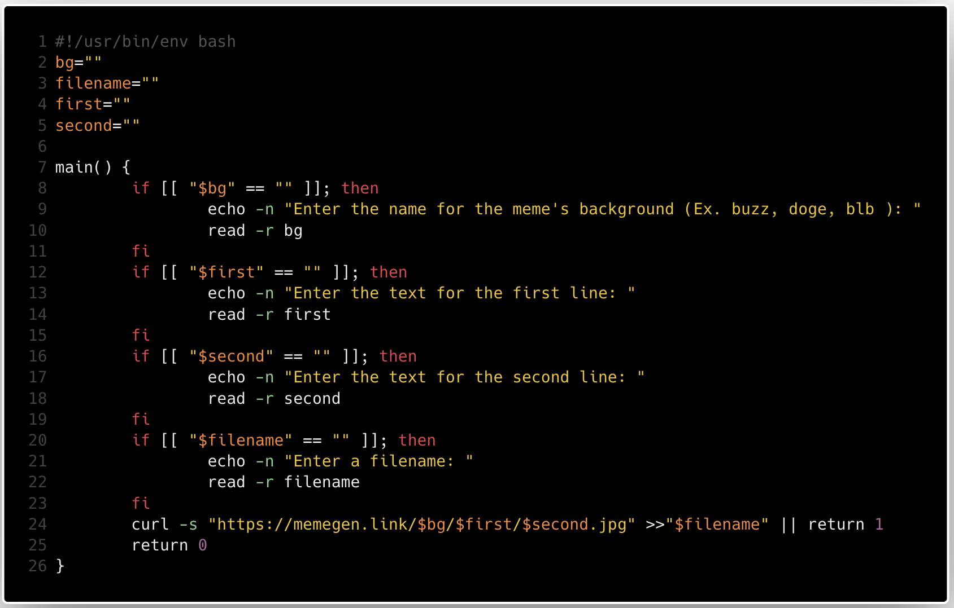

Slide 15
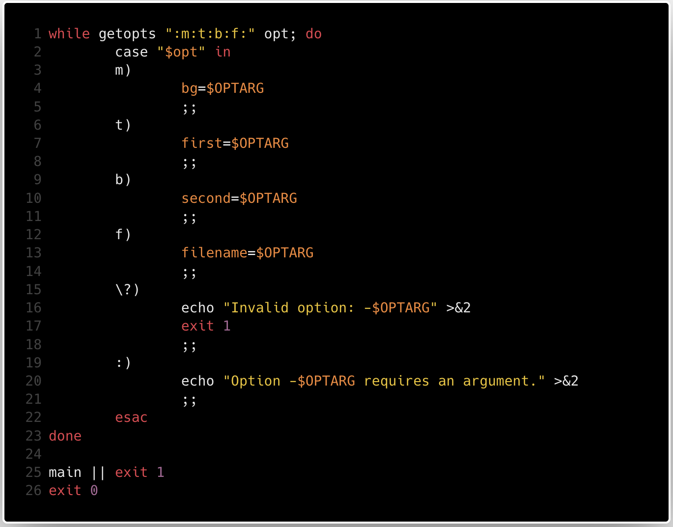

Slide 16
Final iteration
Usability
Usage string
Cat and EOF
Swapping out curl for wget

Slide 17
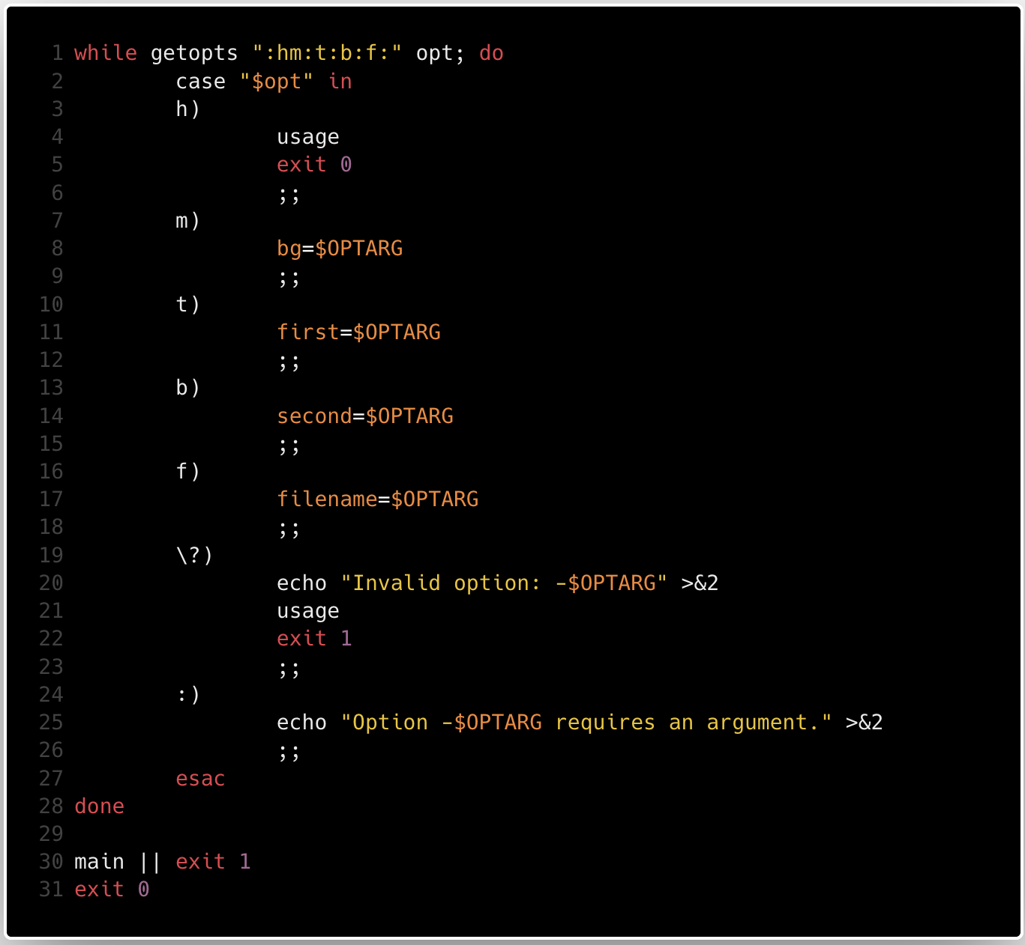

Slide 18
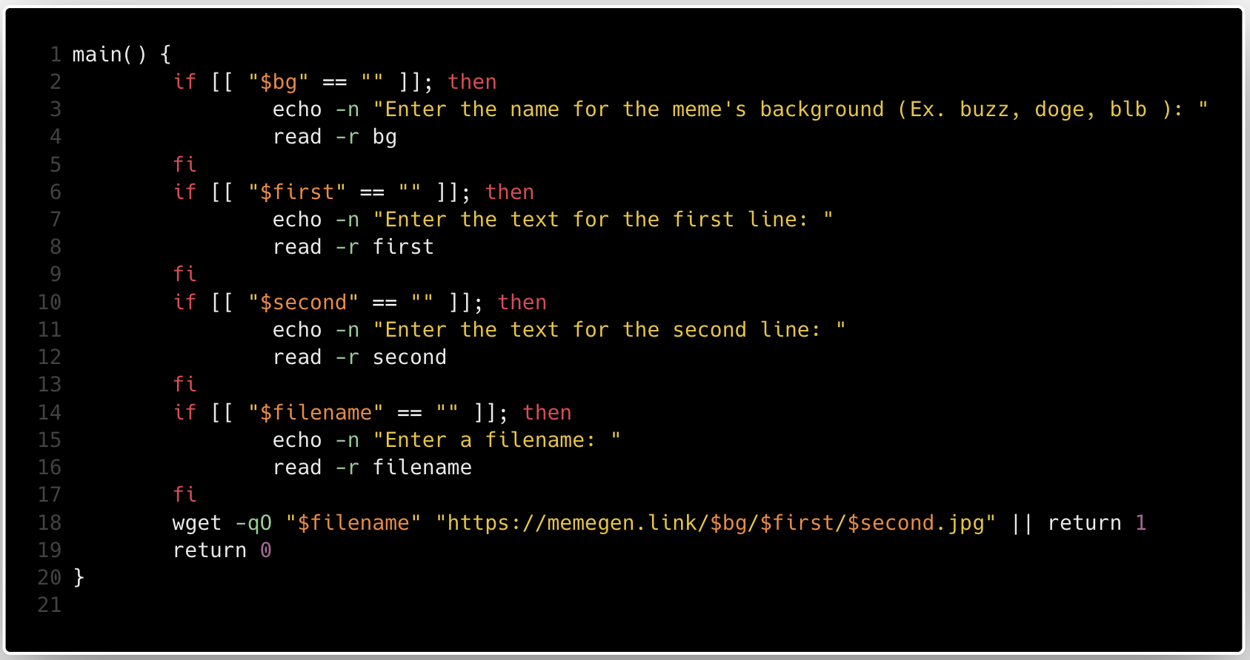

Slide 19
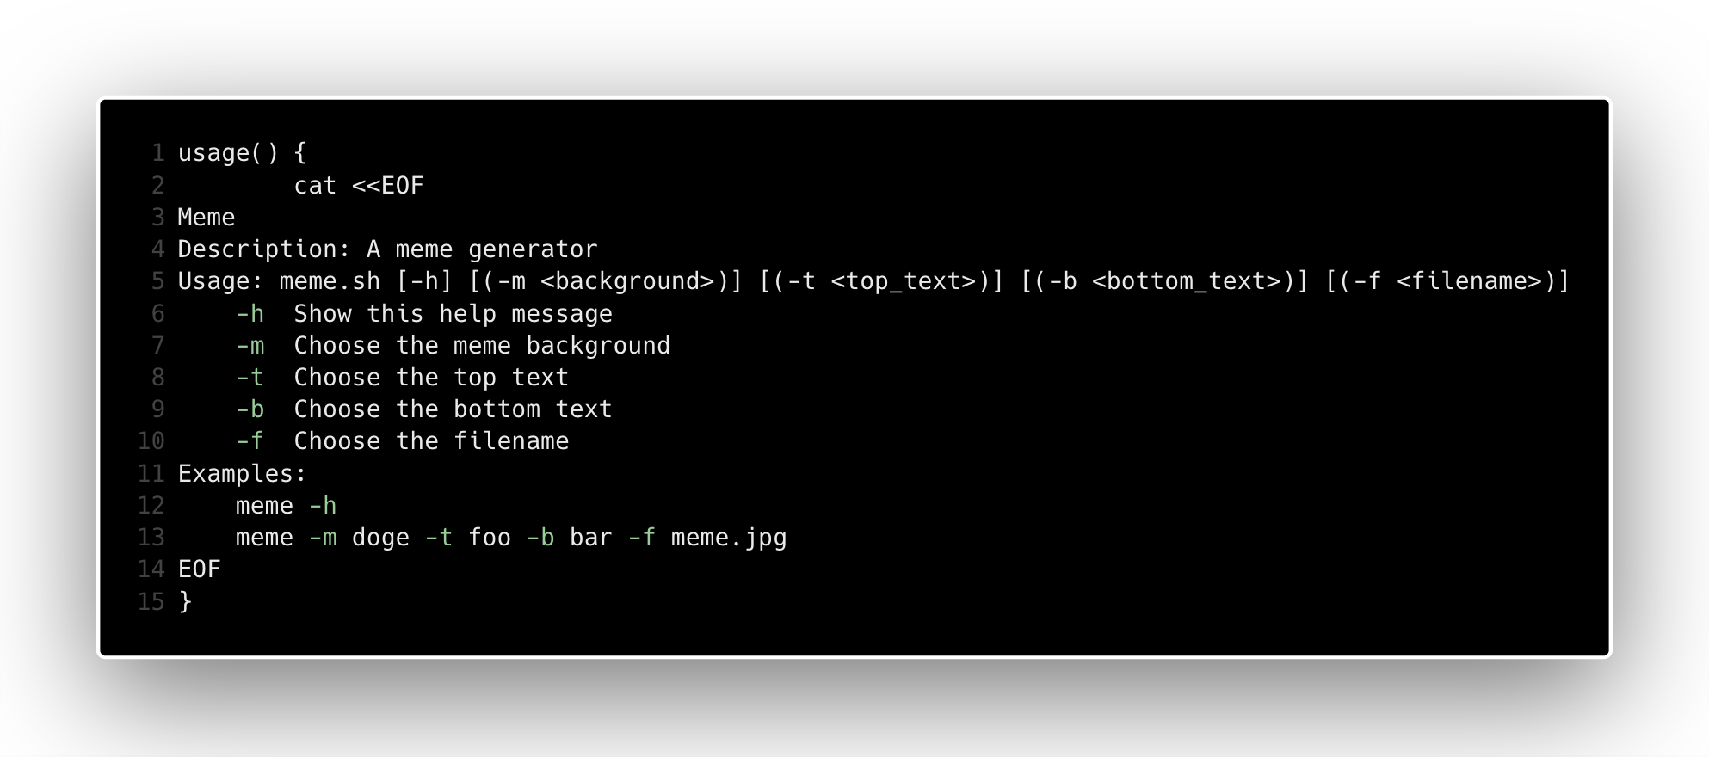

Slide 20
Demo

